Slide 1

Department of Computer Science and Engineering
Automated Chest X-Ray Diagnosis with Deep Ensemble Models: A Focus on COVID-19 and Pneumonia Detection
PRESENTED BY
Shaik Hafija 21471A05C0
Kanneganti Navya 21471A0592
Gorantla Gayathri 21471A0586
Sunkireddy Madhavi 21471A05D0
Under the Guidance of,
S V N Sreenivasu _{Mtech, PhD.},
Designation,
Department of Computer Science and Engineering,
Narasaraopeta Engineering College (Autonomous),
Narasaraopet- 522 601.

Slide 2
OUTLINE
Abstract
Introduction
Literature Survey
Research Gaps
Problem Statement
Objectives
Block Diagram / Flow Diagram
Methodology
Implementation
Results and Analysis
Conclusion & Future Scope
References
Question and Answers
Acknowledgements

Slide 3
ABSTRACT
Our research introduces a robust combo model for diagnosing Covid-19 and pneumonia using chest X-ray images, addressing the limitations of traditional RT-PCR tests. The methodology includes preprocessing with data augmentation techniques like zoom, rotation, and flipping, coupled with deep feature extraction using transfer learning models such as VGG16, DenseNet201, and EfficientNetB0. These features are classified using fully connected layers and ensemble classifiers, achieving an impressive accuracy of 98.5%, with precision, recall, and F1 scores of 95%, 96%, and 95%, respectively. This approach demonstrates enhanced efficiency and reliability, setting a benchmark in automated chest X-ray diagnosis.

Slide 4
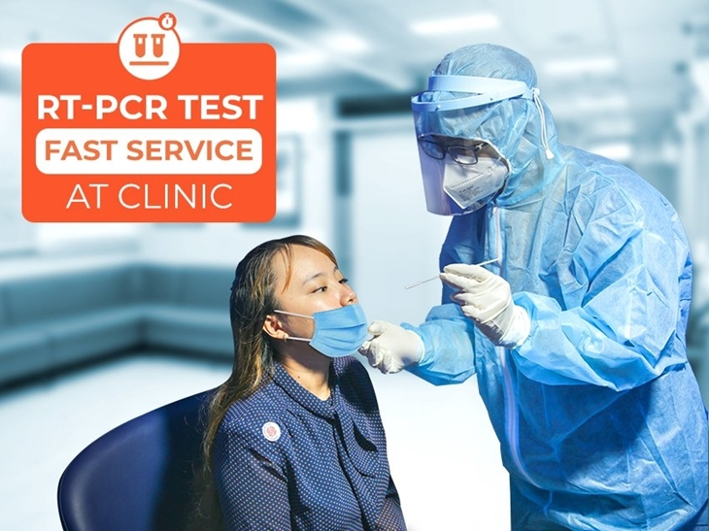
PROBLEM STATEMENT
The problem we are addressing is the need for a rapid, accurate, and cost-effective method to diagnose Covid-19 and pneumonia using chest X-ray images. Traditional diagnostic techniques, such as RT-PCR, are time-consuming, expensive, and often not easily accessible, especially in resource-limited regions. This results in delays in diagnosis and treatment, leading to potentially severe health consequences.
Our goal is to develop an automated system that uses deep learning models to analyze chest X-ray images, providing quick and reliable diagnoses, thereby improving patient care, reducing healthcare burdens, and offering a scalable solution for global healthcare challenges.

Slide 5
INTRODUCTION
Our project focuses on developing an advanced deep learning-based model for diagnosing Covid-19 and pneumonia using chest X-ray images. By leveraging cutting-edge technologies like transfer learning and ensemble classifiers, we aim to provide a more accurate, efficient, and cost-effective alternative to traditional diagnostic methods such as RT-PCR tests.
The Covid-19 pandemic underscored the need for quick and reliable diagnostic tools, particularly in regions lacking access to RT-PCR tests. This project aims to improve diagnostic accuracy, reduce testing time, and leverage widely available chest X-ray imaging to address these challenges effectively.
By tackling the diagnosis of both Covid-19 and pneumonia with 98.5% accuracy, this project enhances healthcare outcomes, supports timely decision-making by professionals, and optimizes patient care and resource utilization in the global health context.

Slide 6
LITERATURE SURVEY
No | Title | Author | Journal Name & Year | Methodology Adapted | Key Findings | Gaps
1 | PneuNet: COVID-19 pneumonia diagnosis on chest X-ray image analysis using Vision Transformer | Tianmu Wang, Zhenguo Nie et al. | Medical, Biological Engineering and Computing & 2023 | Convolutional Neural Networks (CNNs) and Vision Transformer (ViT) | Achieved high accuracy in COVID-19 diagnosis using ResNet18-ViT on X-rays. | lack of model interpretability for clinical applications.
2 | Chest X-Ray Images to Differentiate COVID-19 from Pneumonia with Artificial Intelligence Techniques | Rumana Islam, Mohammed Tarique | International Journal of Biomedical Imaging & 2022. | convolutional neural network (CNN) model (VGG16) with transfer learning. | VGG16 achieved 100% accuracy, and SVM with SURF reached 98.1%, both computationally efficient. | The model is binary and needs optimization for multiclass and gender variations.
3 | Detecting Covid-19 And Other Pneumonia Diseases Using Shufflent Cnn | Zahraa Shahad Marzoog, et al. | Webology & 2022 | ShuffleNet CNN, SVM | Achieved 98% accuracy in three-class and 91.8% in four-class classification. | Performance drops with larger datasets and classes.
4 | Detecting Covid19 and pneumonia from chest X-ray images using deep convolutional neural networks | Nallamothu Sri Kavya, Thotapalli shilpa et al. | Materials Today: Proceedings & 2022 | deep convolutional neural networks (CNN), specifically VGG16 and ResNet50 models. | VGG16 achieved 89.34% accuracy, while ResNet50 achieved 91.39%. | Dataset imbalance and limited evaluation metrics, requiring larger, balanced datasets.
5 | A comprehensive review of analyzing the chest X-ray images to detect COVID-19 infections using deep learning techniques. | Kavitha Subramaniam et al. | Soft Computing & 2023 | CNNs and pre-trained models | Models such as ResNet50 achieved high accuracies. | Lack of uniform datasets and standardized evaluation metrics.

Slide 7
OBJECTIVES
To develop a deep learning-based model for accurate diagnosis of Covid-19 and pneumonia using chest X-ray images.
To create a user-friendly web interface using Flask, HTML, and CSS that allows users to easily upload chest X-ray images for diagnosis and view results in real-time.
To utilize transfer learning with pre-trained models (VGG16, DenseNet201, EfficientNetB0) for effective feature extraction and classification.
To evaluate the model’s performance in terms of accuracy, precision, recall, and F1-score, ensuring it meets the diagnostic standards for healthcare applications.

Slide 8
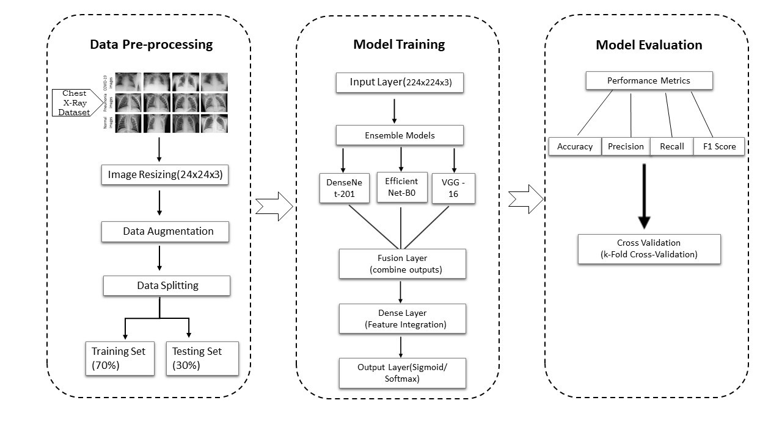
BLOCK DIAGRAM OR FLOW DIAGRAM

Slide 9
Creates the input layer for the model, specifying that it will receive images of size 224×224 pixels with 3 color channels (RGB).
input_shape = (224, 224, 3)
input_layer = Input(shape=input_shape)
We use EfficientNet-B0, VGG-16, and DenseNet-201 models for feature extraction. The output from each model is a feature vector representing important characteristics of the input image.
These vectors contain numerical values capturing different patterns, textures, and structures from the image.
Once we extract features from each model, we concatenate them to form a single feature representation:
concatenated_features = Concatenate()([features_efficientnet, features_vgg16, features_densenet])

Slide 10
After feature fusion, the combined feature vector is passed through fully connected layers
x = Dense(512, activation='relu')(concatenated_features)
x = Dropout(0.5)(x)
The Dense (512, ReLU) layer refines the extracted features. Dropout (0.5) prevents overfitting by randomly deactivating neurons during training.
output_layer = Dense(num_classes, activation='softmax')(x)
ensemble_model = Model(inputs=input_layer, outputs=output_layer)
Softmax activation ensures the model outputs a probability distribution across all classes
Model() builds the architecture by: Taking the input (image data).

Slide 11
METHODOLOGY
Models Utilized: VGG-16, DenseNet-201, and EfficientNet-B0 were combined in an ensemble framework.
Data Preprocessing: Applied data augmentation techniques like resizing, flipping, and contrast adjustments to improve model generalization and reduce overfitting.
Dataset:
COVID-19 images: 3,174 (GitHub).
Normal and Pneumonia images: 2,487 and 1,336 (Kaggle).
Total: Training (4,897 images), Validation (1,050 images), Test (1,050 images).

Slide 12
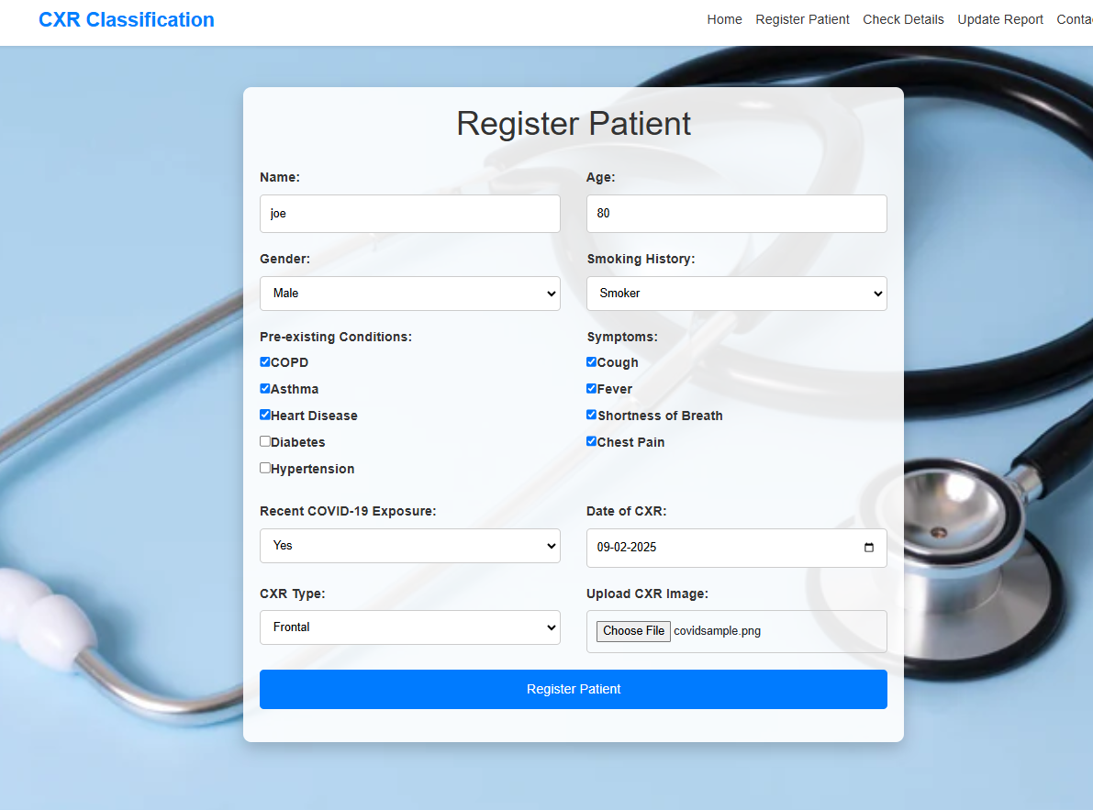
IMPLEMENTATION
We developed the form using HTML and CSS to collect patient details for automated analysis.
The form includes fields for personal information, symptoms, pre-existing conditions, COVID-19 exposure, and CXR details.
We integrated a CXR image classification system that analyzes the uploaded image and categorizes it as Normal, Pneumonia, or COVID-19, generating a detailed diagnostic report.

Slide 13
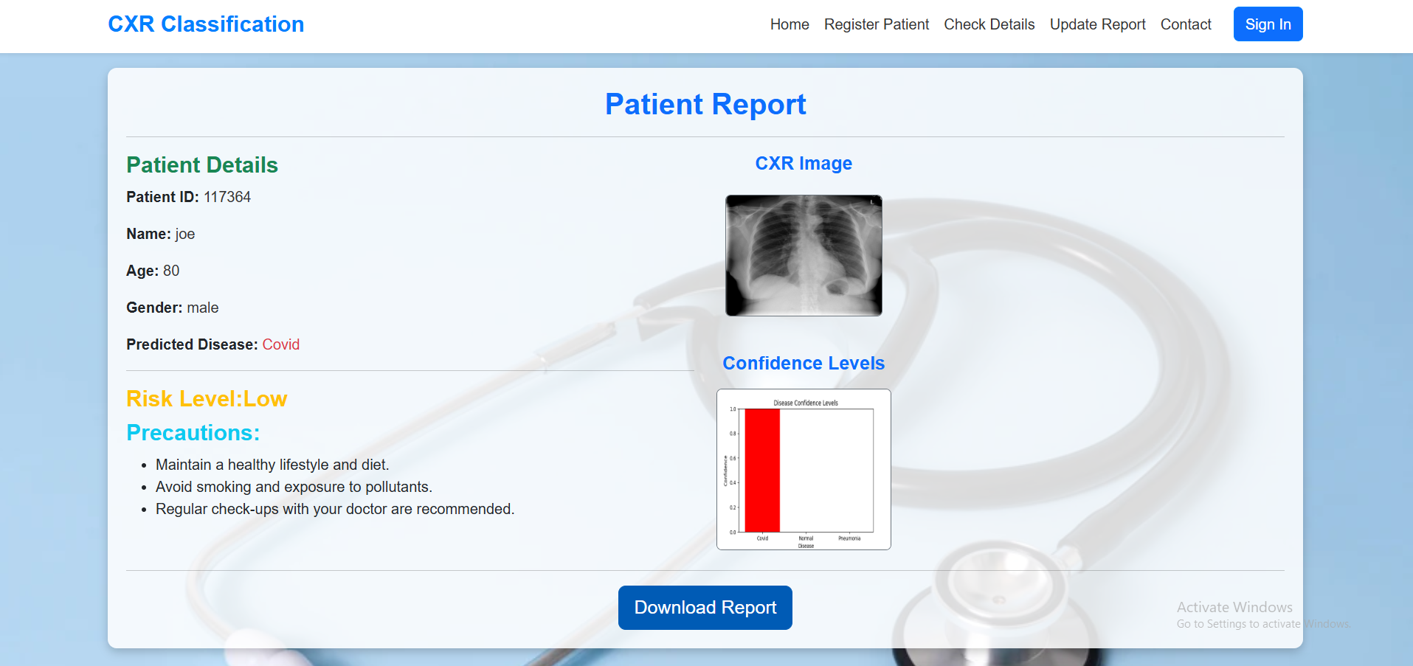
A detailed patient report is generated after processing the submitted details and CXR image. This report includes patient information such as ID, name, age, and gender.
The report presents the predicted disease classification (Normal, Pneumonia, or COVID-19) along with confidence levels, helping in assessing the reliability of the diagnosis. Additionally, a risk level (Low, Medium, or High) is determined based on symptoms and pre-existing conditions.
The report provides precautionary recommendations tailored to the patient's condition and includes a downloadable option, ensuring quick access to diagnostic results .

Slide 14
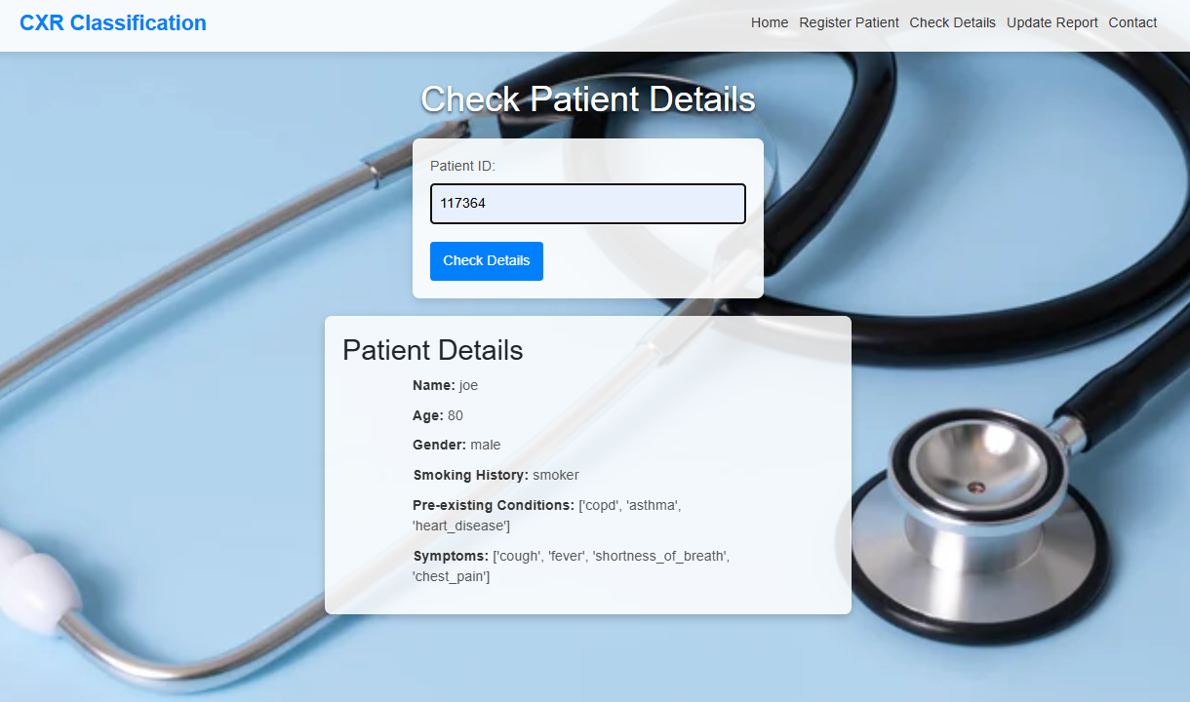
CXR Classification System allows users to retrieve patient details using a unique Patient ID.
displaying key information like age, gender, smoking history, pre-existing conditions, and symptoms.
This user-friendly system enhances medical efficiency, aiding in chest X-ray classification and informed diagnosis.

Slide 15
CONCLUSION and FUTURE SCOPE
The ensemble model achieved high classification accuracy (98.33%) and F1-score (98%), effectively identifying COVID-19 and pneumonia cases.
Combining the strengths of multiple models enhanced robustness and generalization.
The system supports rapid and accurate diagnosis, making it valuable in resource-scarce clinical settings.
Expanding the model to handle additional diseases.
Incorporating real-time deployment in clinical environments.
Improving model interpretability to better assist radiologists.

Slide 16
REFERENCES
Tianmu Wang1,2,3 • Zhenguo Nie1,2,3 • Ruijing Wang4 • Qingfeng Xu1,5 • Hongshi Huang6 • Handing Xu1,2,3 • Fugui Xie1,2,3 • Xin-Jun Liu1,2,3, “PneuNet: Deep learning for COVID-19 pneumonia diagnosis on chest X-ray image analysis using Vision Transformer,” International Federation for Medical and Biological Engineering, vol.61,no., pp.1395-1408, Jan.2023, https://doi.org/10.1007/s11517-022-02746-2.
Rumana Islam and Mohammed Tarique, “Chest X-Ray Images to Differentiate COVID-19 from Pneumonia with Artificial Intelligence Techniques,” International Journal of Biomedical Imaging, vol. 2022, no. , pp. 1-15, Dec. 2022, https://doi.org/10.1155/2022/5318447.
Zahraa Shahad Marzoog, Dr. Manal Hussein Nawir, Fatima Al Zegair, “Detecting Covid-19 And Other Pneumonia Diseases Using Shufflent Cnn,” Webology, vol. 19, no. 3,pp. 2638-2651, Aug. 2022, https://www.researchgate.net/publication/362711388.

Slide 17
QUESTIONS and ANSWERS

Slide 18
ACKNOWLEGEMENTS
We sincerely thank Narasaraopeta Engineering College, Andhra Pradesh, and our mentors Dr. S.V.N. Sreenivasu and Marella Venkat Rao for their guidance. We also acknowledge the open-source communities for providing the datasets used in this study. Special thanks to our families and peers for their unwavering support and encouragement.
•Contact for further inquiries or collaboration:
Email:hafijashaik7876@gmail.com
PhNo:8639538909

